Slide 1



Welcome
Welcome to this presentation about applying various strategic frameworks to analyze Kissflow, a leading workflow automation platform.
by Mukil Arasan

Slide 2


Introduction to Kissflow
Kissflow is a cloud-based workflow automation platform. It offers a wide range of features and solutions for businesses of all sizes, helping them streamline their processes, improve efficiency, and boost productivity.
Workflow Automation
Process Management
Kissflow automates manual processes like approval requests, data entry, and task management. It makes workflows more efficient and reduces errors.
Kissflow allows businesses to visualize, analyze, and improve their processes. It provides insights into process bottlenecks and areas for improvement.
Collaboration
Integration
Kissflow facilitates collaboration by providing a central platform for communication, task assignments, and approvals.
Kissflow integrates with other business applications and systems, enabling seamless data flow and automation.

Slide 3
Porter's Five Forces Analysis of Kissflow
Porter's Five Forces Analysis is a framework that helps analyze the competitive landscape of an industry. It can be applied to Kissflow to assess its competitive strengths and weaknesses.
Threat of New Entrants
Bargaining Power of Buyers
Bargaining Power of Suppliers
The threat of new entrants is moderate, as the workflow automation market is relatively mature, but barriers to entry are low due to the availability of cloud-based solutions.
The bargaining power of buyers is moderate. Buyers have options for different workflow automation solutions, but they are also reliant on providers like Kissflow for features and integration.
The bargaining power of suppliers is moderate. Kissflow relies on technology providers for its platform, but there are alternative suppliers available.

Slide 4
PESTLE Analysis for Kissflow
PESTLE analysis is a framework used to identify external factors affecting an organization. This analysis can be applied to Kissflow to understand the macro-environmental factors impacting its business.
Political
Government regulations on data privacy and security, political stability in key markets
Economic
Economic growth, interest rates, currency exchange rates, inflation
Social
Changing workforce demographics, increasing adoption of digital technologies, growing demand for automation
Technological
Advancements in artificial intelligence, cloud computing, and mobile technologies, cybersecurity threats
Legal
Data protection laws, intellectual property rights, labor laws
Environmental
Environmental regulations, sustainability initiatives, energy consumption

Slide 5

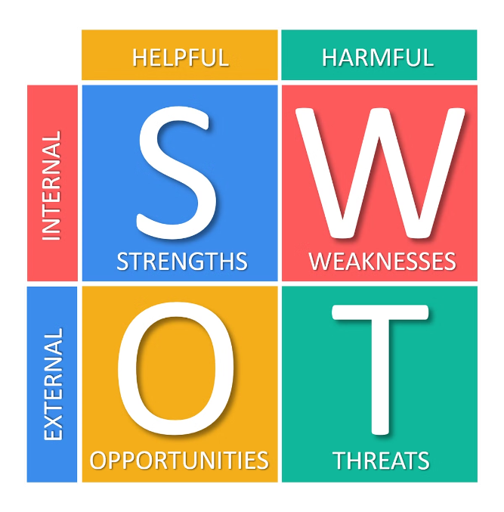
SWOT Analysis of Kissflow
SWOT analysis is a framework that helps identify internal strengths and weaknesses, and external opportunities and threats. This framework can be applied to Kissflow to develop strategies for growth and competitiveness.
1
Strengths
2
Weaknesses
User-friendly interface, comprehensive features, strong integration capabilities, positive customer reviews, brand recognition.
Limited customization options for advanced workflows, pricing can be a concern for some customers, customer support may have room for improvement.
3
Opportunities
4
Threats
Expanding into new markets, developing specialized solutions for different industries, partnering with technology companies for integration.
Competition from established players in the workflow automation market, economic downturn, cybersecurity breaches.

Slide 6

Marketing Mix Model Application for Kissflow
The Marketing Mix Model, also known as the 4Ps, helps identify the key elements of a marketing strategy. This framework can be applied to Kissflow to understand how it positions itself in the market.
Product
Price
Place
Promotion
Kissflow offers a comprehensive workflow automation platform with features like process management, automation, collaboration, and integration.
Kissflow offers different pricing plans based on the number of users and features required, catering to businesses of different sizes.
Kissflow distributes its platform through its website, online marketplaces, and partnerships with technology companies.
Kissflow uses a mix of marketing strategies like content marketing, social media marketing, email marketing, and public relations.

Slide 7





The 3 C's Framework for Kissflow
The 3 C's Framework helps analyze a company's competitive position and market opportunity. It can be applied to Kissflow to understand its strategic direction.
Company
Kissflow's strengths, weaknesses, resources, and capabilities are crucial for its success.
Customer
Understanding customer needs, preferences, and expectations is essential for developing relevant solutions.
Competition
Analyzing competitors' strengths, weaknesses, and strategies helps Kissflow position itself effectively.

Slide 8

Product Life Cycle Analysis for Kissflow
The Product Life Cycle Analysis helps understand the stages of a product's development and its impact on marketing strategy. This framework can be applied to Kissflow to assess its current stage and plan for the future.
Introduction
Maturity
Kissflow is in its growth stage. It has gained significant market share and is actively expanding its product offerings and customer base.
As the workflow automation market matures, Kissflow will need to focus on innovation, differentiation, and customer retention to maintain its market share.
1
2
3
4
Growth
Decline
Kissflow is experiencing rapid growth as more businesses adopt workflow automation solutions. Its marketing focus is on generating awareness and expanding its reach.
While a decline is not expected in the near future, Kissflow will need to adapt to changing market dynamics and technological advancements.

Slide 9



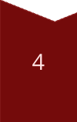

MECE Framework for Kissflow
The MECE framework, which stands for Mutually Exclusive, Collectively Exhaustive, is a structured approach to problem-solving and decision-making. This framework can be applied to Kissflow to ensure that all aspects of its business are considered.
Identify the Problem
The problem could be a decline in sales, customer churn, or a lack of innovation.
Break Down the Problem
Break the problem down into smaller, more manageable parts. Each part should be mutually exclusive and collectively exhaustive.
Analyze Each Part
Analyze each part of the problem in detail, considering all relevant factors.
Develop Solutions
Develop solutions for each part of the problem, ensuring that they are effective and address the root cause.
Implement and Monitor
Implement the solutions and monitor their effectiveness. Make adjustments as needed to ensure success.

Slide 10


Thank You
Thank you for your time and attention. I hope this presentation has provided valuable insights into applying strategic frameworks to analyze Kissflow.

